Slide 1
PIZZA PRICE PREDICTION
Link : https://www.kaggle.com/knightbearr/pizza-price-prediction
Dataset : pizza_v1.csv

Slide 2
MY LEARNINGS :
Concept of Logistic regression
Treating outliers
Exploratory Data Analysis
Model Building using OLS
Model Building using SGD

Slide 3
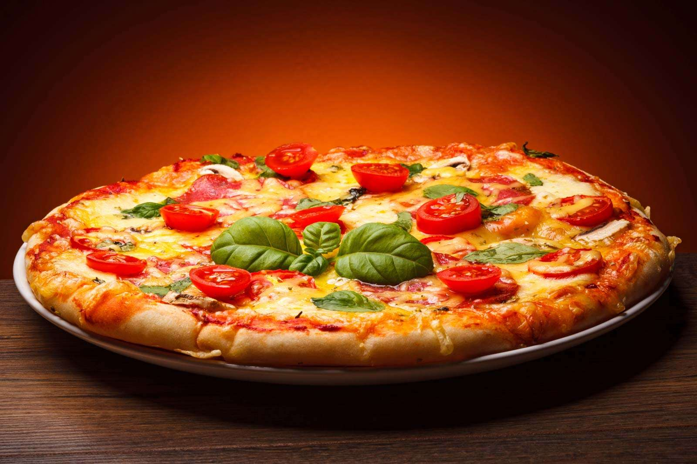
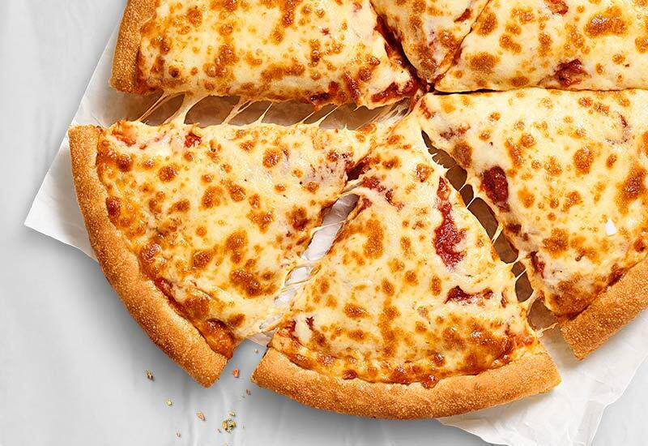
GOAL :
This dataset is for predicting the prices of pizza. The prediction is to be made upon the given features.

Slide 4
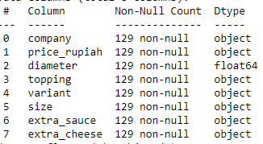
FEATURES :

Slide 5
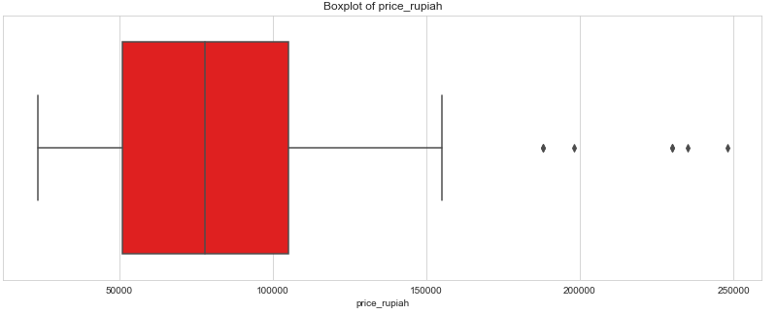
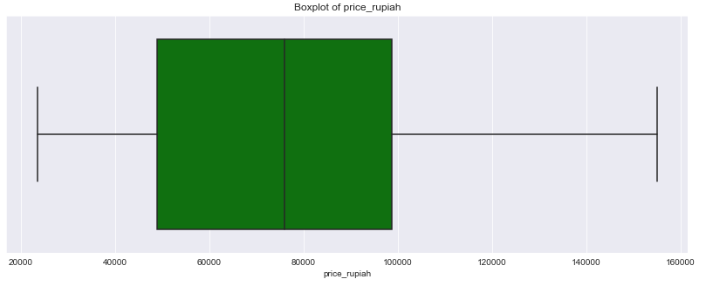
DATA MANIPULATION :
Treating Outliers
After treating

Slide 6
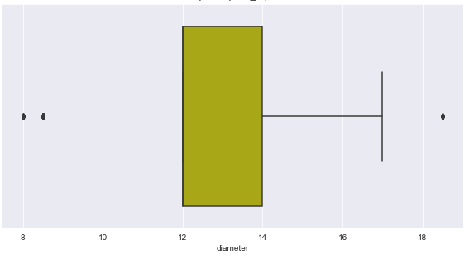
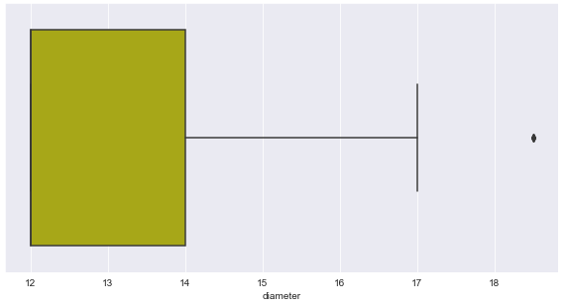
DATA MANIPULATION :
Treating Outliers
After treating

Slide 7
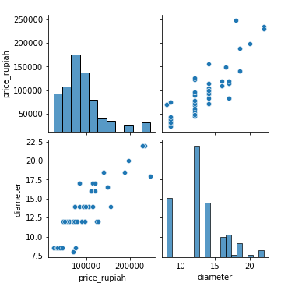
EDA :
PAIRPLOT :

Slide 8
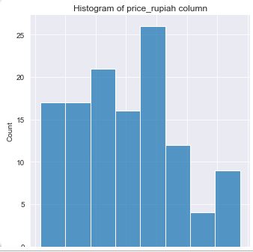
EDA :
price rupiah [Target Variable]
The mean price is 87,151 rupiah (around 5.20 euros) The cheapest pizza in the dataset is 23,500 rupiah (1.40 euro) The most expensive one is 248,000 rupiah (14.77 euro)

Slide 9
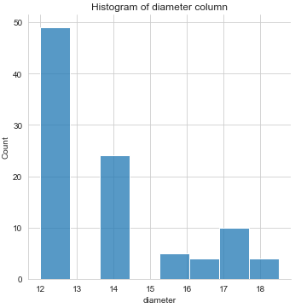
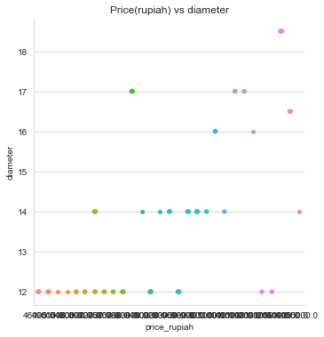
EDA :
diameter
The mean diameter is around 13 inches The minimum diameter is 8 inches The maximum diameter is 22 inches

Slide 10
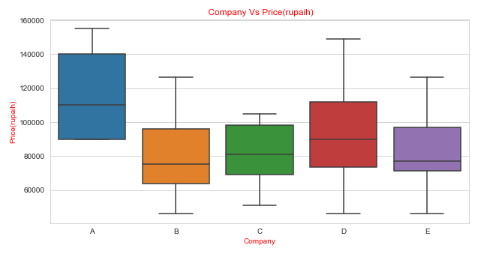
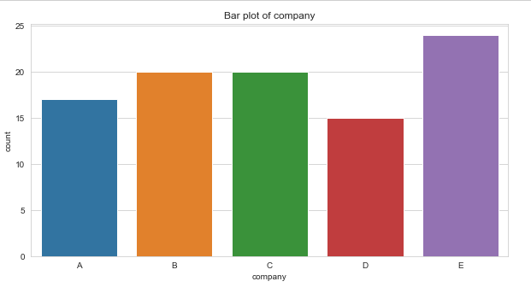
EDA :
company

Slide 11
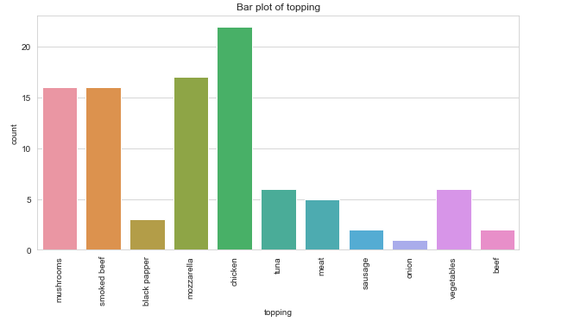
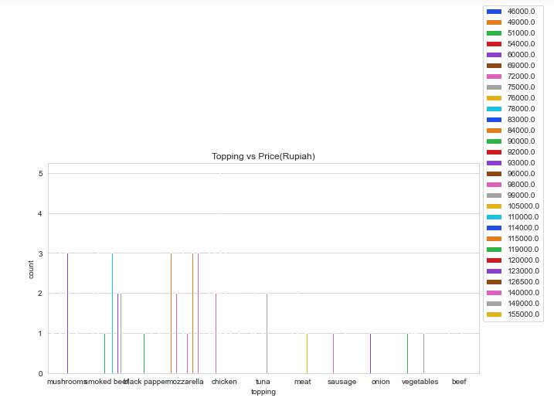
EDA :
topping
From this plot we can say:
Pepperoni pizza on average are more expensive than other pizzas.
There are some outliers for mozzarella, mushrooms and chicken pizzas.
It looks like there is just one onion pizza
The most popular toppings among the pizzas are chicken, mushrooms, smoked beef and mozzarella

Slide 12
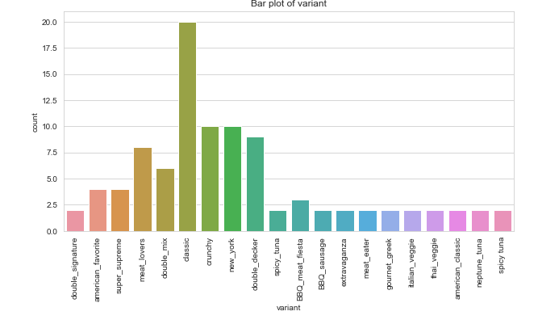
EDA :
variant

Slide 13
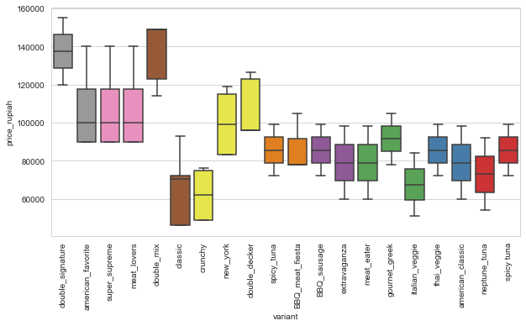
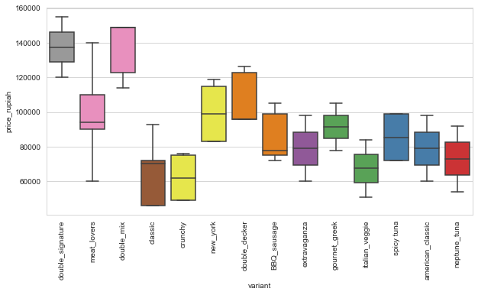
EDA :
Clubbing the columns based on Tukey HSD (Honestly significant difference) test and on description in order to improve model’s accuracy.
After clubbing
variant

Slide 14
EDA :
variant
From this plot we can say that:
Double signature and double mix pizzas are more expensive than the other pizzas.
In particular, double signature pizza date has a large variance.
Classic and Italian veggies are cheaper on average.

Slide 15
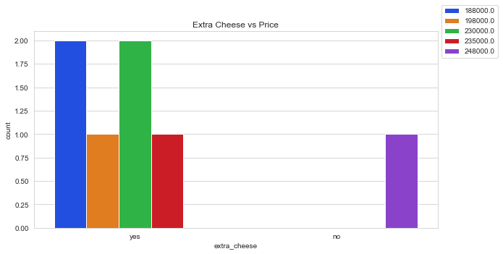
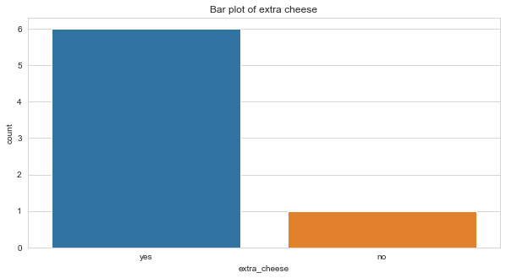
EDA :
Extra cheese

Slide 16
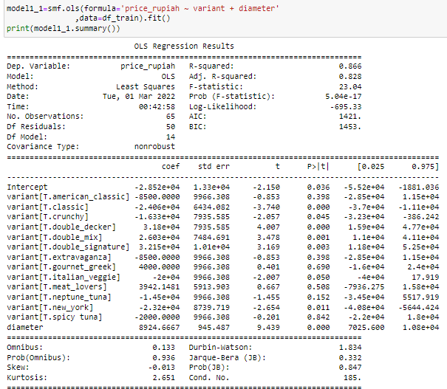
MODEL BUILDING :
USING OLS (Ordinary least squares method) METHOD
MODEL 1 :
R- SQUARE = 0.866

Slide 17
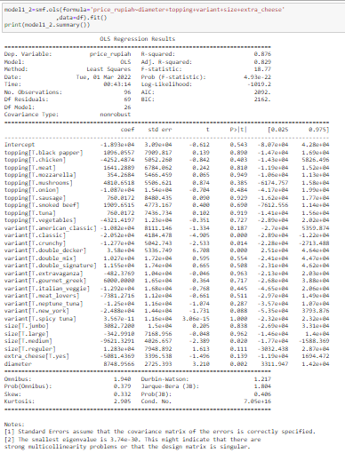
USING OLS (Ordinary least squares method) METHOD
MODEL 2:
R-SQUARE = 0.87

Slide 18

USING SGD (Stochastic Gradient Descent) METHOD
MODEL 3 :

Slide 19
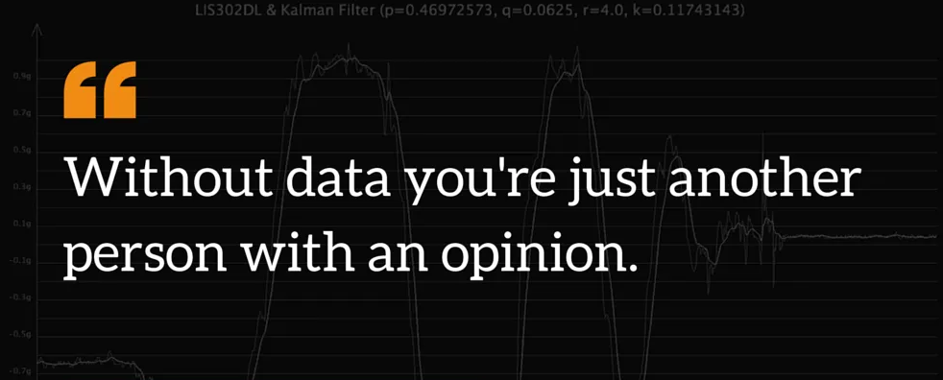
THANKS FOR VIEWING MY WORK!

